Slide 1
Bridging the Communication Gap
Todd Meinershagen

Slide 2
Requirement Levels
What?
Impact/Goal
Feature/Epic
(Question)
User Story
Reminder for a discussion
How?
Code
Easy
(Difficulty Defining Up Front)
Hard

Slide 3
Items to Discuss
Acceptance Criteria: Specification by Example
Automated Acceptance Testing: SpecFlow
Living Documentation: Relish/Pickles

Slide 4
Items to Discuss
Acceptance Criteria: Specification by Example
Automated Acceptance Testing: SpecFlow
Living Documentation: Relish/Pickles

Slide 5

Traditional requirements are too abstract and take obvious things for granted.

Slide 6
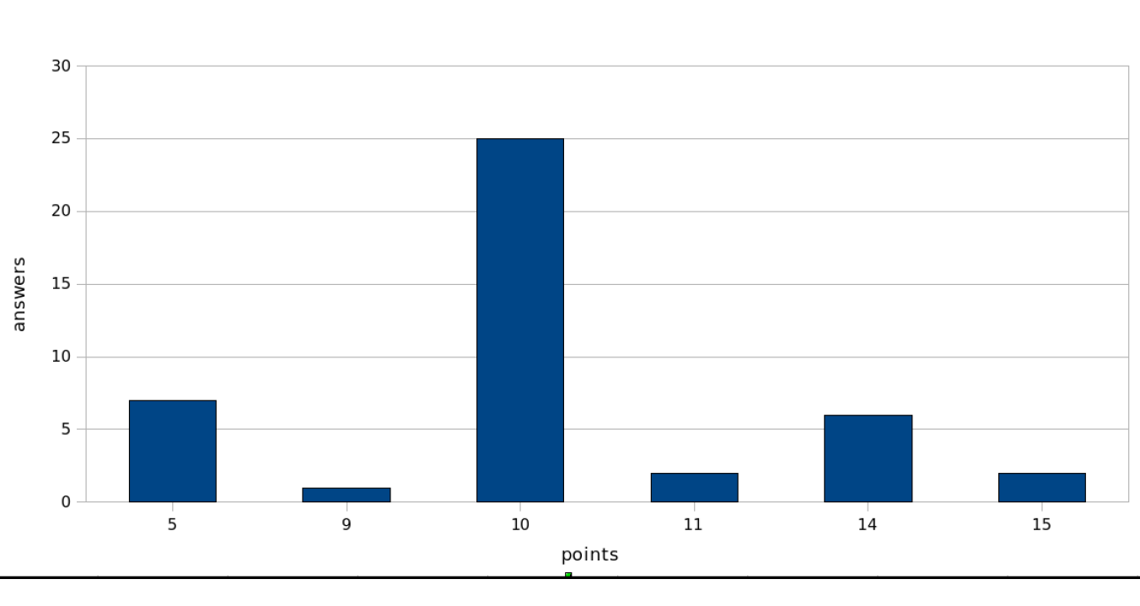
Traditional requirements are too abstract and take obvious things for granted.

Slide 7
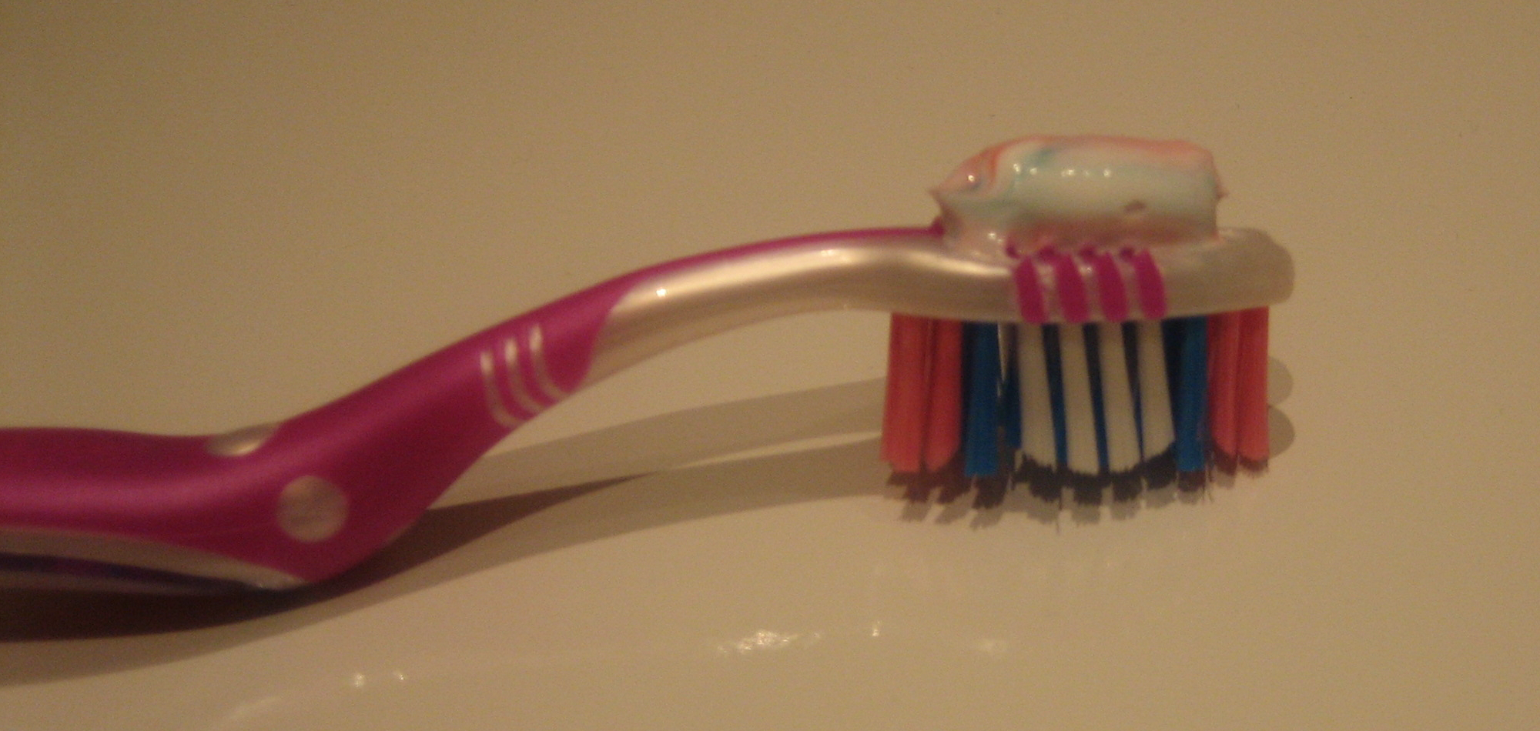
An example is better than a list of instructions.

Slide 8




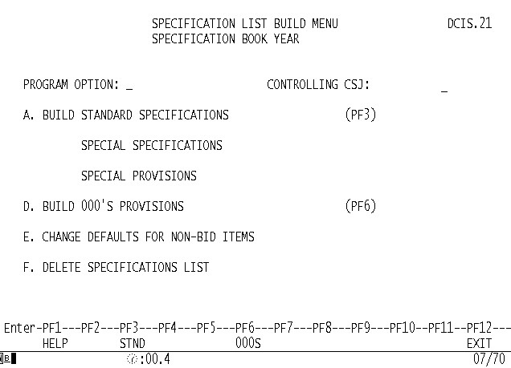


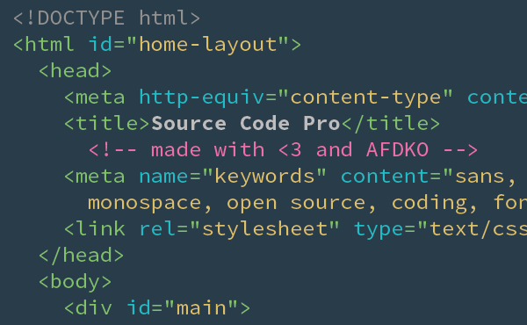
Examples live everywhere.
(Defects)
Product Owner
Customer
(Test Cases)
(Specification)
Developer
(Code)
Tester

Slide 9

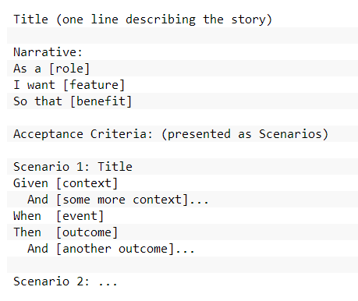
Use a consistent, gherkin syntax.

Slide 10
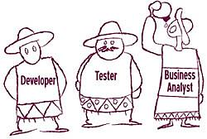
Specify collaboratively as much as possible.

Slide 11
Specify collaboratively as much as possible.
What should it DO?

Slide 12
Specify collaboratively as much as possible.
How do I MAKE it?
What should it DO?

Slide 13
Specify collaboratively as much as possible.
How do I BREAK it?
How do I MAKE it?
What should it DO?

Slide 14
Items to Discuss
Acceptance Criteria: Specification by Example
Automated Acceptance Testing: SpecFlow
Living Documentation: Relish/Pickles

Slide 15



:: About
Created in 2009 and sponsored by
Open source, available via
More info at http://www.specflow.org

Slide 16
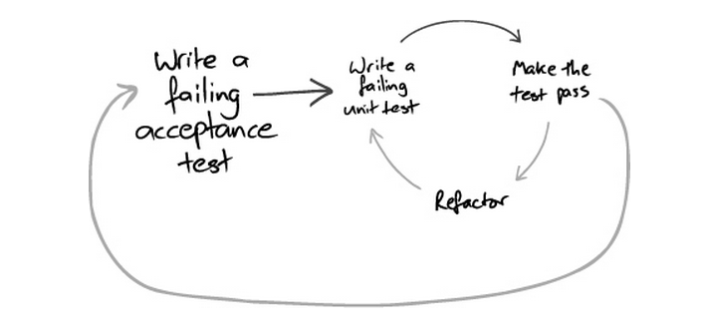
:: Feature-level, not unit-level.

Slide 17

:: Demo

Slide 18
Items to Discuss
Acceptance Criteria: Specification by Example
Automated Acceptance Testing: SpecFlow
Living Documentation: Relish/Pickles

Slide 19
:: About
A service where developers can publish living documentation about the software they’re writing.
Created in Scotland by Matt Wynne who works on Cucumber, the Ruby equivalent of SpecFlow.

Slide 20
:: Demo

Slide 21

Questions?

Slide 22
Find Code For Demos Here:
https://github.com/toddmeinershagen/Demo.SpecByExample.Begin

